Slide 1

Federal Coordination for Traumatic Brain Injury Research:
The National Research Action Plan
An Interagency Approach to Chronic Problems
Stuart W. Hoffman, Ph.D.
Scientific Program Manager for Brain Injury
Office of Research and Development
US Department of Veterans Affairs
Stuart.hoffman@va.gov

Slide 2
Disclosure
The views expressed are in this presentation do not represent the views of the U.S. Government, Department of Defense, HHS, ED, or any other agency either public or private.
I have no relevant financial relationships.

Slide 3
Objectives
How do Federal Agencies cooperate on a common initiative?
The goals of this initiative
Examples of the National Research Plan in Action

Slide 4

Historical Background for the Initiative
Japanese Geisha [Photograph]. (2006). Retrieved April 10, 2006, from: http://www.bergoiata.org/fe/divers28/10.htm - See more at: http://www.landmark.edu/library/citation-guides/landmark-college-citation-guides/apa-citation-style-guide/#Images
The Sphere [Photograph]. Retrieved August 25, 2014 at
en.wikipedia.org/wiki/The_Sphere
The Sphere is a large metallic sculpture by German sculptor Fritz Koenig, currently displayed in Battery Park, that once stood in the area between the World Trade Center towers in Manhattan. After being recovered from the rubble of the Twin Towers after the 9/11attacks, its fate was initially uncertain and it was dismantled into its components. Although it remained structurally intact, it had been visibly damaged by debris from the airliners that were crashed into the buildings and the collapsing skyscrapers themselves.

Slide 5
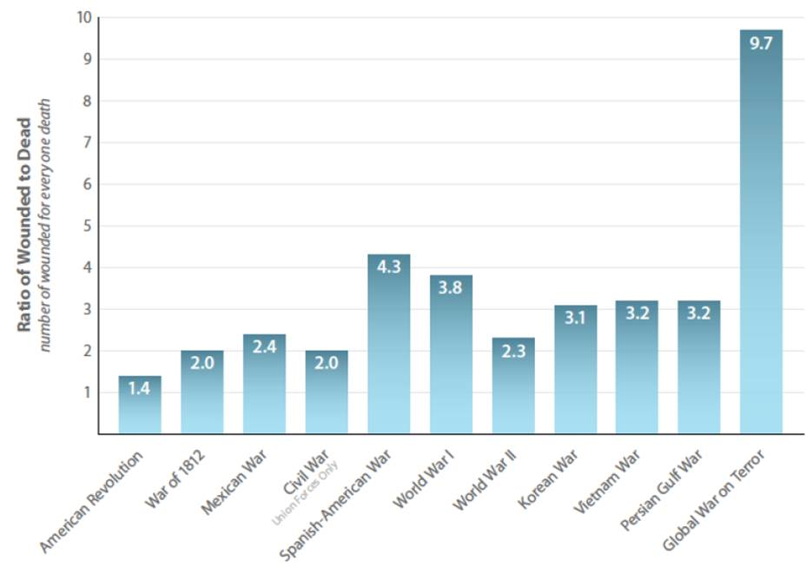
Background
Wounded to Dead Ratio
From the American Revolution to GWOT
Since September 11, 2001, more than 2.5 million service members have deployed to Iraq and Afghanistan in Operation Enduring Freedom, Operation Iraqi Freedom, and Operation New Dawn. Military forces sent to fight those wars have exhibited a number of unique features, including:
  an all-volunteer military that has experienced multiple deployments to the war zone,
  substantial use of the reserve components of the military and National Guard,
  deployment of high numbers of women and parents of young children,
  a high number of military personnel surviving severe injuries that in previous wars would have resulted in death.
IOM (Institute of Medicine), 2014

Slide 6
The Legacy
Improvements in outer tactical vests (body armor) and helmets have limited fatal injuries, many service members return with a TBI, PTSD, suicidal thoughts or behaviors, and/or related comorbidities.
These comorbidities or co-occurring conditions are defined as mental health disorders by the NRAP.
Returning Veterans who were seen in VA health care facilities revealed:
  that nearly one-third of Veterans received at least one mental health or psychosocial diagnosis.
  Another study estimated that only 23% to 40% of returning service members who screen positive for a mental disorder seek mental health care.
  Family members are also impacted by the multiple stressors associated with deployment and reintegration.
  These conditions are anticipated to increase in coming years as the Nation endures the effects of more than a decade of military conflict.

Slide 7
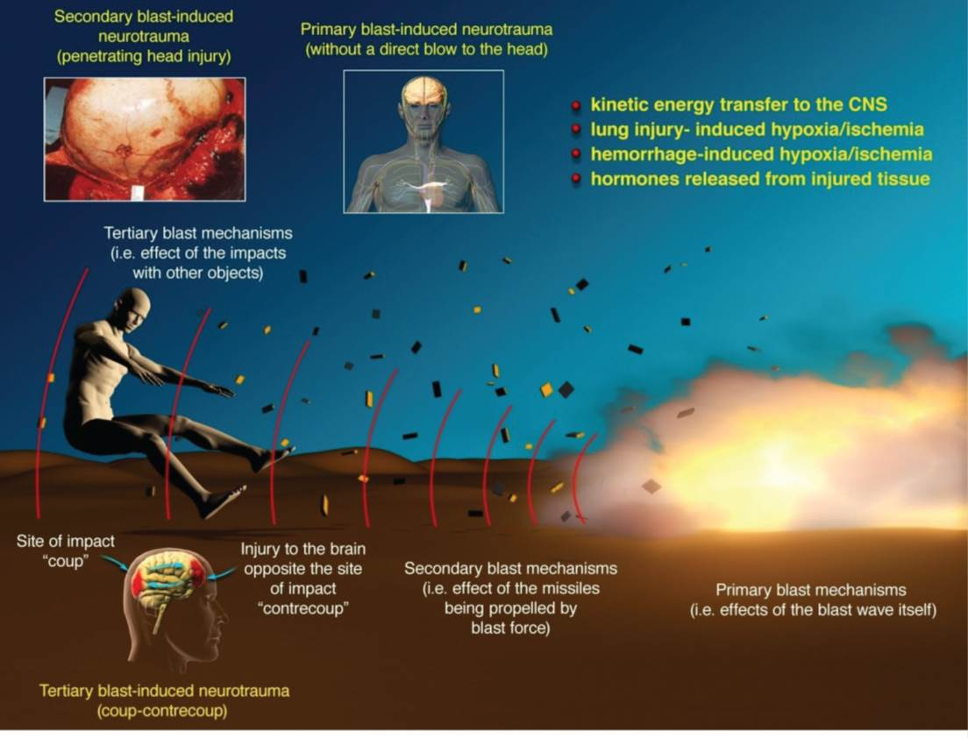
Signature Wound: The Unknown Prognosis
IOM (Institute of Medicine), 2014

Slide 8
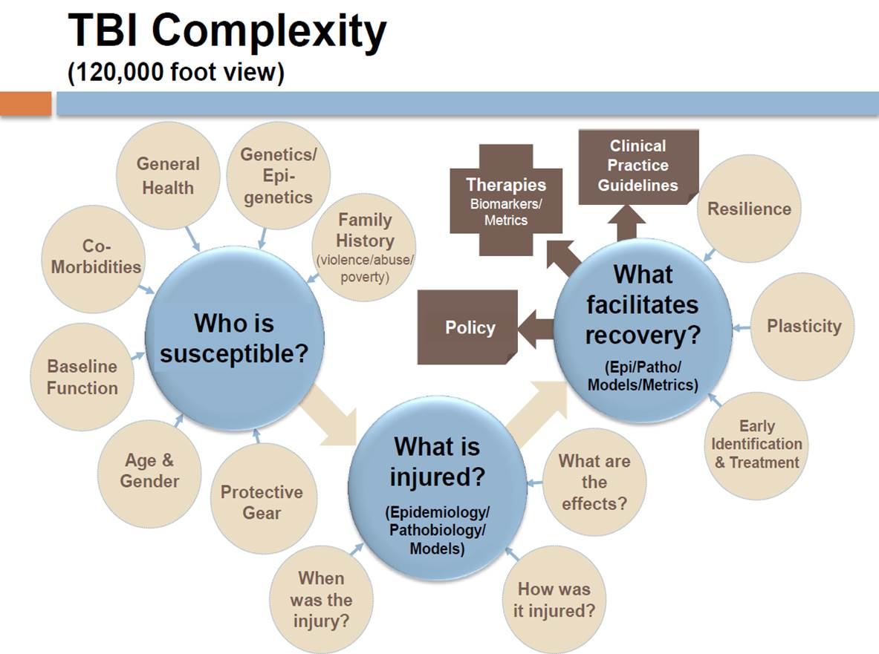
Hack, D. (Digital Image), 2014

Slide 9
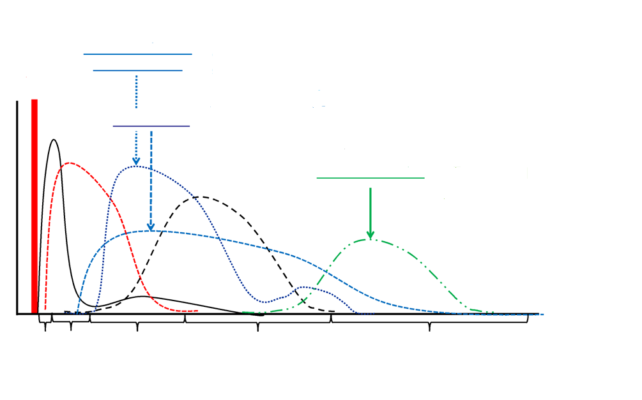
Previous Focus: Acute Mechanisms & Therapies
Acute
Post-Acute
Chronic
Excitotoxic damage
Oxidative stress
Excitotoxic damage
Oxidative stress
Injury
Inflammation
[Protein Biomarker] blood
Axonal injury
Apoptosis
Neuroregeneration
Neurodegeneration?
Demyelination
Microgliosis
Min Hr Days Weeks Months Years→
Consciousness Cognitive/Behavioral/Sensory Deficits Reintegration Dementia?
Table courtesy of Dr. Hoffman

Slide 10
Executive Order 13625 Sec. 5: PTSD, TBI, Suicide Prevention
“The lack of full understanding of the underlying mechanisms of Post Traumatic Stress Disorder (PTSD), other mental health conditions, and Traumatic Brain Injury (TBI) has hampered progress in prevention, diagnosis, and treatment. In order to improve the coordination of agency research into these conditions and reduce the number of affected men and women through better prevention, diagnosis, and treatment, the Departments of Defense, Veterans Affairs, Health and Human Services, and Education, in coordination with the Office of Science and Technology Policy, shall establish a National Research Action Plan within 8 months of the date of this order.”

Slide 11
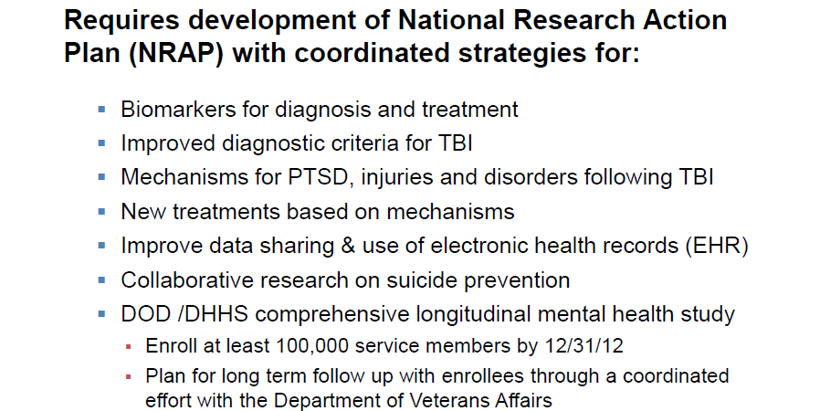
Executive Order 13625 Sec. 5: Goals
Department of Defense, Department of Veterans Affairs, Department of Health and Human Services, Department of Education, 2012

Slide 12

Authors and Active Participants
A
Psychological Health COL (ret.) Carl Castro, USARMY CAPT Carroll Forcino, USN Dr. Theresa Gleason, VA/ORD Dr. Farris Tuma, HHS/NIMH LTC Dennis McGurk, USARMY Dr. Katherine Nassauer, USARMY Dr. Thomas Insel, HHS/NIMH Dr. Susan Borja, HHS/NIMH Dr. Eve Reider, HHS/NID | TBI COL Dallas Hack, USARMY Dr. Kenneth Curley, USARMY COL Wanda Salzer, USARMY Dr. Walter Koroshetz, HHS/NINDS Dr. Ramona Hicks, HHS/NINDS Dr. Cate Miller, ED/NIDRR Dr. Stuart Hoffman, VA/ORD Dr. Shirley Groer, VA/ORD Dr. Robert O’Brien, VA/ORD Dr. Arlene Greenspan, HHS/CDC | Leadership Dr. Michael Stebbins, OSTP Dr. Philip Rubin, OSTP Dr. Timothy O’Leary, VA/ORD Dr. Terry Rauch, DoD Dr. Kelley Brix, DoD Dr. Robert Jaeger, VA/ORD Ruth Brannon, ED/NIDRR
google.com/imgres?imgurl=http://www.elitconsultancy.com/assets/img/ass1.png&imgrefurl=http://www.elitconsultancy.com/&h=500&w=870&tbnid=RDQ9lF3NUX90EM&zoom=1&tbnh=170&tbnw=296&usg=__0pEP6xgLxVVmJ6hHT_u1kdLn9KA=

Slide 13
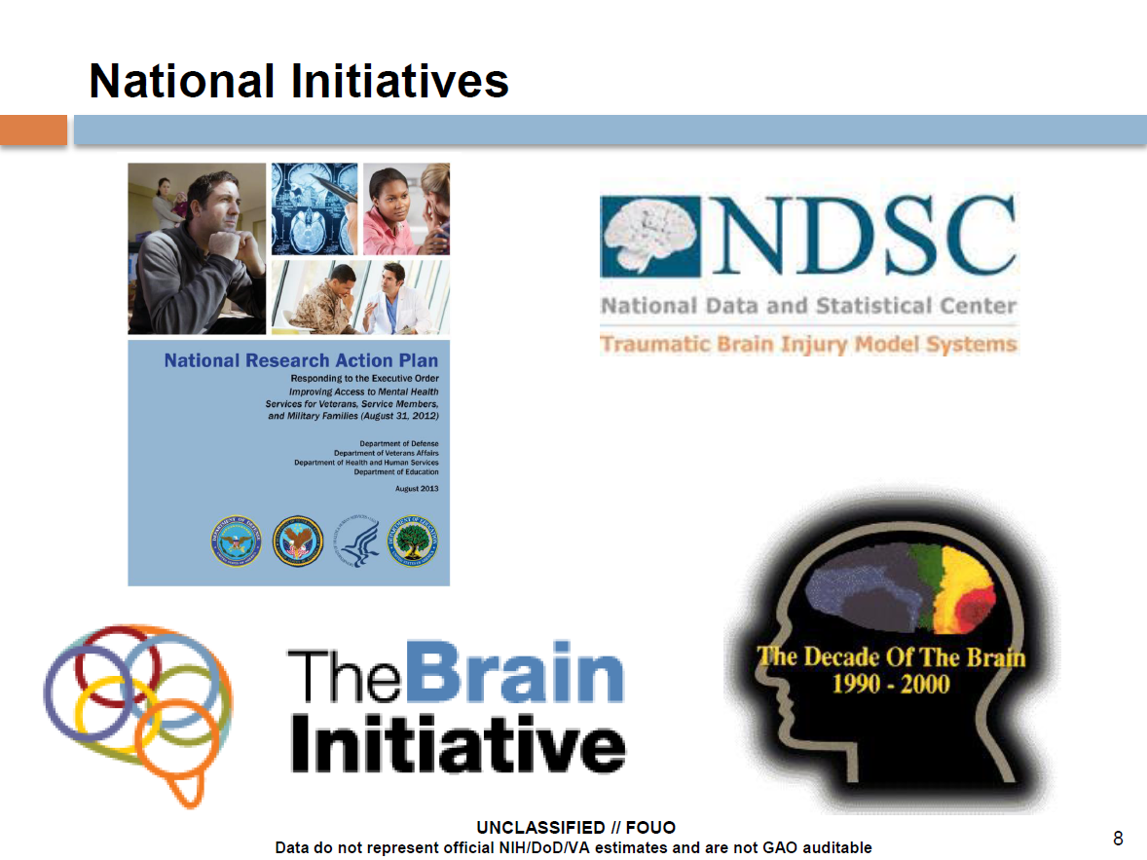
craighospital.org/repository/image/Research/NDSCLogo.jpg
whitehouse.gov/sites/default/files/uploads/nrap_for_eo_on_mental_health_august_2013.pdf
lcweb.loc.gov/loc/brain/images/doblogo2.gif

Slide 14
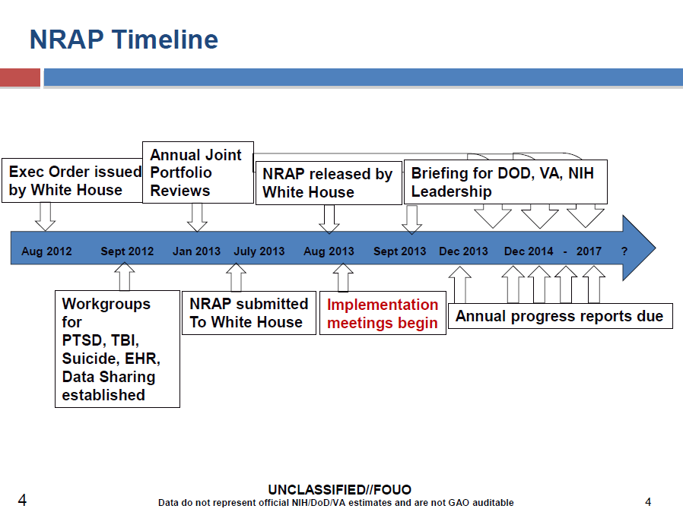
Table courtesy of Dr. Hoffman

Slide 15
Current Treatment Research in: Post-Acute Therapies
Acute
Post-Acute
Chronic
Excitotoxic damage
Oxidative stress
Excitotoxic damage
Oxidative stress
Injury
Inflammation
[Protein Biomarker] blood
Axonal injury
Apoptosis
Neuroregeneration
Neurodegeneration?
Demyelination
Microgliosis
Min Hr Days Weeks Months Years→
Consciousness Cognitive/Behavioral/Sensory Deficits Reintegration Dementia?
Table courtesy of Dr. Hoffman

Slide 16
Injury/Recovery Trajectories
IOM (Institute of Medicine), 2014
Examples of possible long-term consequences after exposure to blast.
Panel A—some service members who are exposed to blast will develop acute injuries and will fully recover within a short period of time, fully recover over a long period of time, or develop chronic diseases and disabilities.
Panel B—some service members who are exposed to blast will not experience acute clinically apparent injuries, but may later develop diseases or disabilities, either in the mid- or long term.
Panel C—some service members who are exposed to blast will develop acute injuries and then will go on to develop chronic diseases or disabilities even though they had apparently recovered or at least partially recovered in the short term.

Slide 17
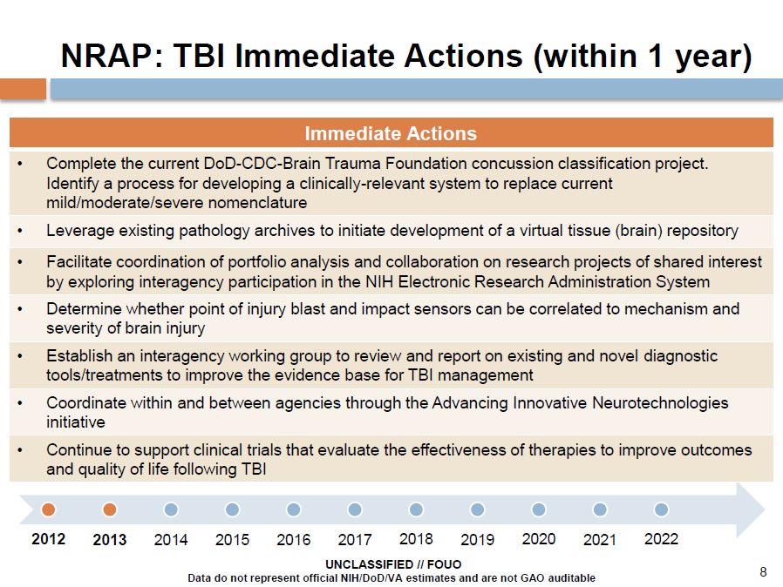
Table courtesy of Dr. Hoffman

Slide 18
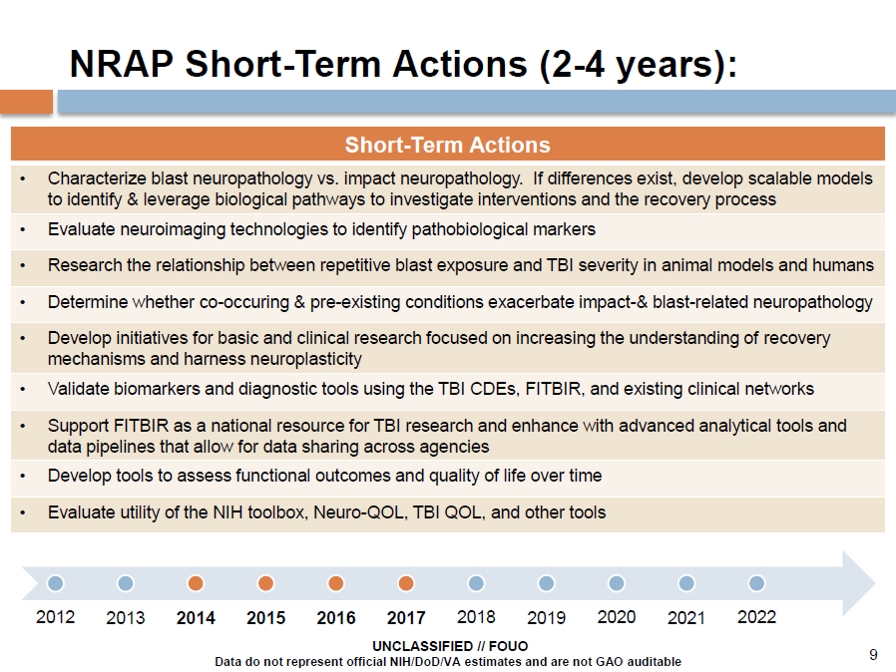
Table courtesy of Dr. Hoffman

Slide 19
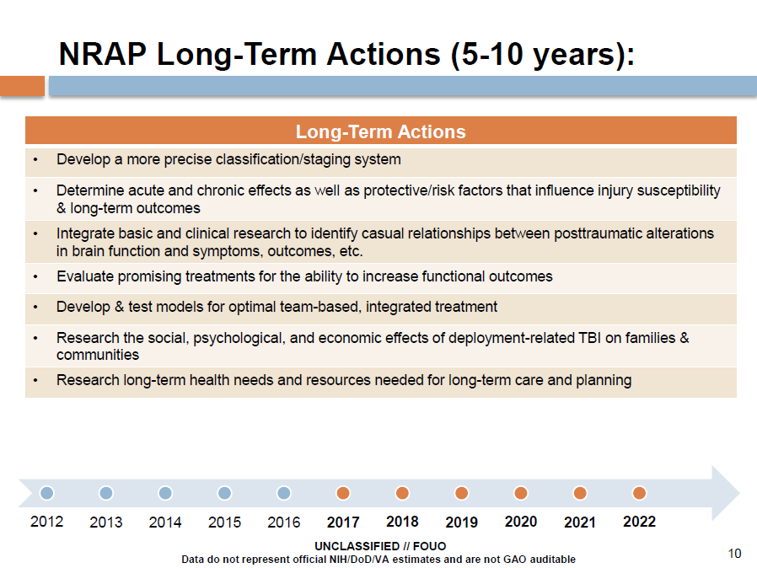
Table courtesy of Dr. Hoffman

Slide 20
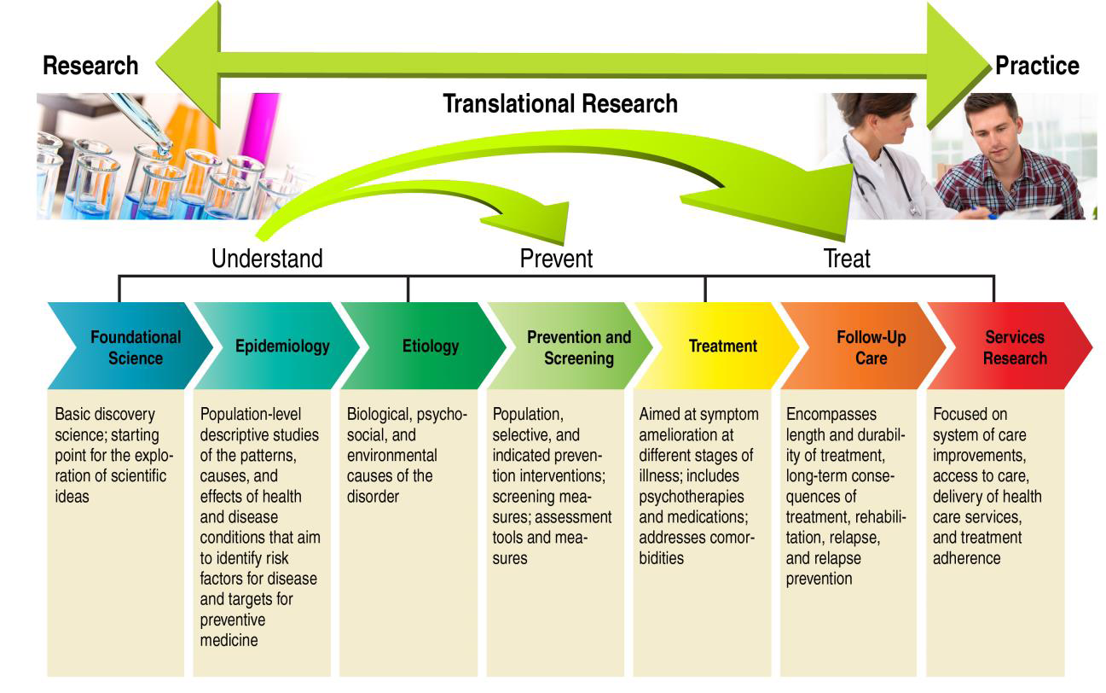
Portfolio Review and Analysis Across Agencies
Department of Defense, et al (Digital Image), 2013

Slide 21
Bottom Line
TBI is a continuum of extremely heterogeneic insults to the sub cellular and cellular structure and function of the brain; effects can be life-long
Co-morbidities (PTS, Pain, Depression) are more the rule than the exception
Currently, physical/mental rest and education are the only validated “treatments” and there are no FDA approved therapies
Regulatory science is inadequate—a reflection of the state of the science in general. Need for validated “endpoints” for both diagnosis and treatment
Because of our limited understanding of the pathobiology, along with a paucity of biomarkers, correlating the human condition with animal models is subjective
The relationships between TBI, neurodegeneration and Chronic Traumatic Encephalopathy are yet to be clearly defined
Does recovered mean recovered or does it mean compensated?
Despite all of the above, we DO find ourselves at a “tipping point” where coordinated foundational efforts will establish the basis for future studies and real, evidence-based progress in the diagnosis and treatment of TBI

Slide 22


A dedicated joint DoD/VA effort addressing the long term consequences of TBI in Service Members and Veterans.
Aligned to Presidential Executive Order 13625 and the National Research Action Plan
$62.175M of VA and DoD Funding
  up to $5M/year for 5 years VA; $37.175M DoD FY12, awarded September 2013
Oversight via Government Steering Committee with representation from DoD, VA, NIH, NIDRR
Currently Supporting 6 Studies across 18 Participating Institutions*
  VCU (Coordinating Center, Dr. David Cifu)
  Uniformed Services University of the Health Sciences
  RTI International
  Richmond VA Medical Center
  Tampa VA Medical Center
  Houston VA Medical Center
  South Texas Health Care System
  San Francisco VA Medical Center & NICRE
  Milwaukee VA Medical Center
  Mountain Home VA Medical Center
  San Antonio Military Medical Center
  Baylor Medical Center
  Duke University
  Roskamp Institute
  Barrows Neurological Institute
  Brigham Young University
  University of Washington
Seattle
Milwaukee
San
Francisco
Salt Lake City
Bethesda
Richmond
Phoenix
Mountain
Home
Durham/ Research Triangle Park
Coordinating Center & Research Site
San Antonio
Research Site
Houston
Tampa
Research Sites & Core
* as of September 2014
Research Core
https://cenc.rti.org
Notes:
Longitudinal Cohort Study (Lead PI: W. Walker, Virginia Commonwealth University)
Tau Conformation and Phosphorylation in mTBI (Lead PI: E. Mufson, Rush University)
Epidemiology Study (Lead PI: K. Yaffe, University of California, San Francisco & San Francisco VA)
Assessment of Long-Term Outcome & Disability in Active-Duty Prospectively Examined Following Concussive TBI (ADAPT) (Lead PI C. MacDonald, University of Washington)
Otolith Dysfunction and Postural Stability (Lead PI: F. Akin, Mountain Home VA)
Diffusion Tensor Imaging (DTI) Standardization Study (Lead PI: E. Wilde, Baylor College of Medicine/Houston VA)

Slide 23
Consortium Objectives
To establish the association (onset, prevalence, and severity) of the chronic effects of mild TBI (mTBI) and common comorbidities*
Determine whether there is a causative effect of chronic mTBI/concussion on neurodegenerative disease and other comorbidities*
Identify diagnostic and prognostic indicators of neurodegenerative disease and other comorbidities associated with mTBI/concussion
Develop and advance methods to treat and rehabilitate chronic neurodegenerative disease and comorbid effects of mTBI/concussion
Highlights
Core facilities for common research efforts
Alignment with DVBIC 15 Year Study for TBI
Leverages
  Multiple DoD and VA clinical sites
  previously funded in-theater efforts for follow up data
  DoD and VA Centers of Excellence
  Nationwide expertise of established research networks
Use of common data elements (CDEs) and entry of data into FITBIR
Robust Peer Review Program to identify new projects
* Comorbidities include: psychological, neurological (memory, seizure, autonomic dysfunction, sleep disorders), sensory deficits (visual, auditory, vestibular), movement disorders, pain (including headache), cognitive, and neuroendocrine deficits
Notes:
Highlights/Successes:
The consortium has leveraged a robust portfolio of previously funded DoD research and networks to rapidly deploy within the first year. Successes include:
Close working relationships with DVBIC investigators to align the Consortium’s Longitudinal Cohort Study with efforts within the DVBIC 15 year study for TBI.
Establishment of scientific working groups that combine consortium investigators with external scientific leaders to better guide the interventions, assessments, and outcome measures of Consortium studies.
The Consortium Leadership and Investigators are collaborators on a number of other high-profile TBI research efforts centered at other institutions around the country.
Engagement of DoD and VA Centers of Excellence in the areas of Hearing (balance), Pain, and Vision to better address the consortium objectives and focus areas.
Close interactions with the CAP leadership
Consortium studies leverage formerly funded efforts to better focus new studies and maximize scientific output.
The consortium’s longitudinal study was developed using lessons learned from an FY07 CDMRP-managed effort to the study PI, Dr. William Walker.
E.g. Consortium has brought on Dr. Christine MacDonald, University of Washington, formerly at Washington University, to collect early-phase chronic assessment data on subjects that were part of a landmark in-theater study led by Dr. David Brody (CDMRP managed FY07 and FY09 efforts). This will enable us to get data on outcome progress from a clinically verified TBI injury.
All study data are being collected using common data elements and all data collected from Consortium studies will be deposited into the Federal Interagency Traumatic Brain Injury Research (FITBIR) informatics registry. The long term goal of which is to provide a resource for researchers to collaboratively compare study findings and accelerate TBI research.
The consortium solicits new studies via a peer review program which is aimed at building new collaborations in order to address both unmet and newly identified scientific gaps.
The consortium has a number of centralized research cores which all studies utilize in some capacity. These include a data management core, biostatistics core, bio-repository, neuropathology core, and neuroimaging core.
The neuropathology core is working with Dr. Ann McKee, Boston University and Boston VA. Dr. McKee and her team are known for a number of scientific advances. The public is most aware of her efforts with respect to neuropathology of chronic traumatic encephalopathy (CTE), especially among athletes (football, wrestling, hockey).
The consortium has encountered a number of challenges which have taken considerable effort to work through. While many challenges have been resolved, the consortium works hard to address those which take more time and effort. Challenges include
Synchronization of DoD and VA funding which are executed by the each respective agency.
Synchronization of research in academic, military treatment facility, and VA medical centers.
Coordination of regulatory approvals. Here, the consortium has a central “gate keeper” within the data management core at RTI. This individual is responsible for coordination and synchronization of all human and animal regulatory approvals among the consortium and ultimately with the DoD and VA regulatory oversight groups.
The CENC Peer Review Program disseminates RFPs widely among resources such as the NIH TBI Listserv, CDMRP email notification systems, and other VA and DoD outreach mechanisms.
Wide dissemination presents a particular challenge with respect to application receipt.
The CENC has received hundreds of inquiries from interested collaborators resulting in a high number of applications or pre-applications which must be thoroughly evaluated in a timely manner.
Despite this challenge, the consortium is continually looking for collaborators to enhance the consortium research portfolio

Slide 24
Approved CENC Projects &
Research Cores
Approved Studies* | Integrated Research Cores
Longitudinal Cohort Study | Biostatistics, Data Management and Study Management
ADAPT | Biorespository & Biomarkers Core
Otolith Dysfunction and Postural Stability | Neuroimaging Core
Epidemiology of mTBI and Neurosensory Outcomes | Neuropathology Core
Tau Conformation
DTI Standardization
* Quad Charts can be found at the end of the slide deck
Notes:
The Consortium developed a roadmap to align the Consortium activities with the DoD/VA and NRAP priorities and objectives

Slide 25
CENC Project Alignment to DoD/VA National Research Action Plan Priorities
NRAP Objective | CENC projects or actions
Classify/Stage mTBI, including imaging and biomarkers | Longitudinal Cohort Study, DTI Standardization
Acute/Chronic Effects of mTBI and risk factors | Longitudinal Cohort Study, Epidemiology /Outcomes Study, Otolith Dysfunction and Postural Stability Study, TBD New Projects*
Causal effects b/n mTBI, longitudinal effects and degenerative changes, including imaging, biomarkers | Longitudinal Cohort Study, Epidemiology /Outcomes Study, ADAPT, DTI Standardization, TBD New Projects*
Efficacy of pharmacologic and non-pharmacologic interventions | TBD New Projects*
Efficacy of Team Interventions for MTBI | TBD New Projects*
Family and community effects of mTBI | Longitudinal Cohort Study, Epidemiology/Outcomes Study, and TBD New Projects*
Long-term health needs after mTBI | Longitudinal Cohort Study, Epidemiology/Outcomes Study, ADAPT and TBD New Projects*
Promote collaboration and data sharing | TBD New Projects* & FITBIR submissions
* New projects solicited via the CENC Peer Review Program
Notes:
The Consortium developed a roadmap to align the Consortium activities with the DoD/VA and NRAP priorities and objectives

Slide 26
Study Alignment to Consortium Objectives
 | Association | Causative Effect | Identify Diagnostic and Prognostic Indicators | Develop / advance treatment and rehabilitation methods
Longitudinal Cohort Study | • | •
ADAPT Study | • | • | •
Otolith Dysfunction & Postural Stability Study | •
Epidemiology of mTBI and Neurosensory Outcomes Study | • |  | • | •
Tau Conformation Study |  | • | •
DTI Standardization Effort | • |  | • | •
Areas to address via new studies | • | • | • neurodegeneration | •
Notes:
Note: Please see previous slide for full text of objectives
Association
Longitudinal Cohort Study
Assessment of Long -Term Outcome & Disability in Active-Duty Military prospectively examined following concussive TBI (ADAPT)
Otolith Dysfunction and Postural Stability
Epidemiology of mTBI and Neurosensory Outcomes
DTI Standardization Effort
Causative Effect
Longitudinal Cohort Study
Tau Conformation Study
ADAPT
Identify diagnostic and prognostic indicators
Tau Conformation Study
Epidemiology of mTBI and Neurosensory Outcomes (retrospective data analysis)
ADAPT (neuroimaging findings)
DTI Standardization Effort
Develop/advance treatment and rehabilitation methods
Epidemiology of mTBI and Neurosensory Outcomes (retrospective analysis of clinical outcomes with respect to patient care; no new interventional strategy)
DTI Standardization Effort

Slide 27
Table courtesy of Dr. Hoffman

Slide 28
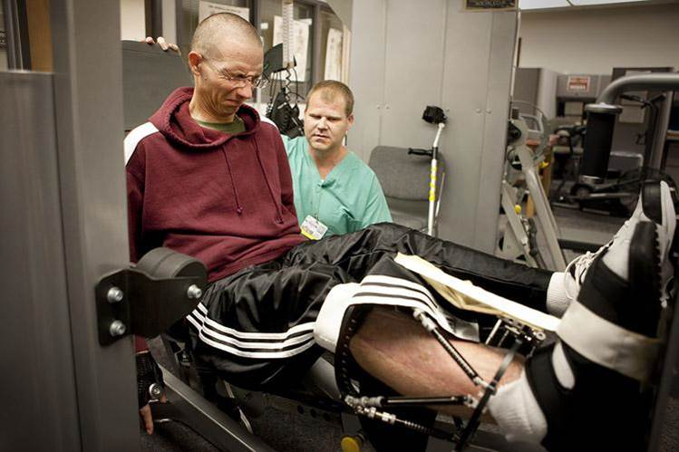
End
Take Home Message:
NRAP has White House visibility
Please take the to time download and read the NRAP
Cite NRAP in your justifications where appropriate
Think Long-Term!
Contact Information:
Stuart.Hoffman@va.gov
202.443.5762
Department of Veterans Affairs (Photograph). (n.d.). Retrieved August 25, 2014 from polytrauma.va.gov/

